Slide 1
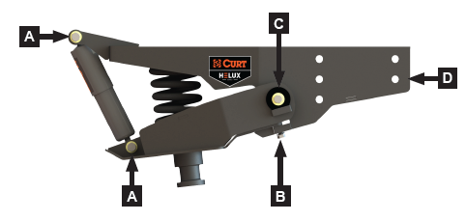
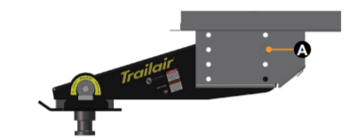

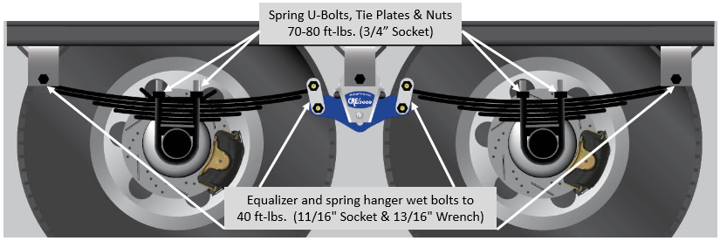
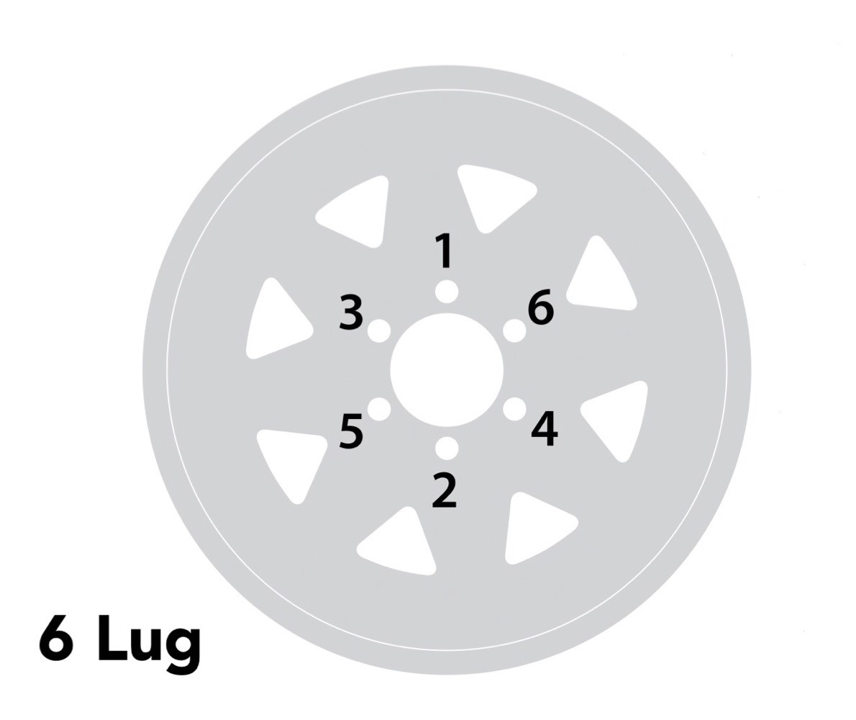
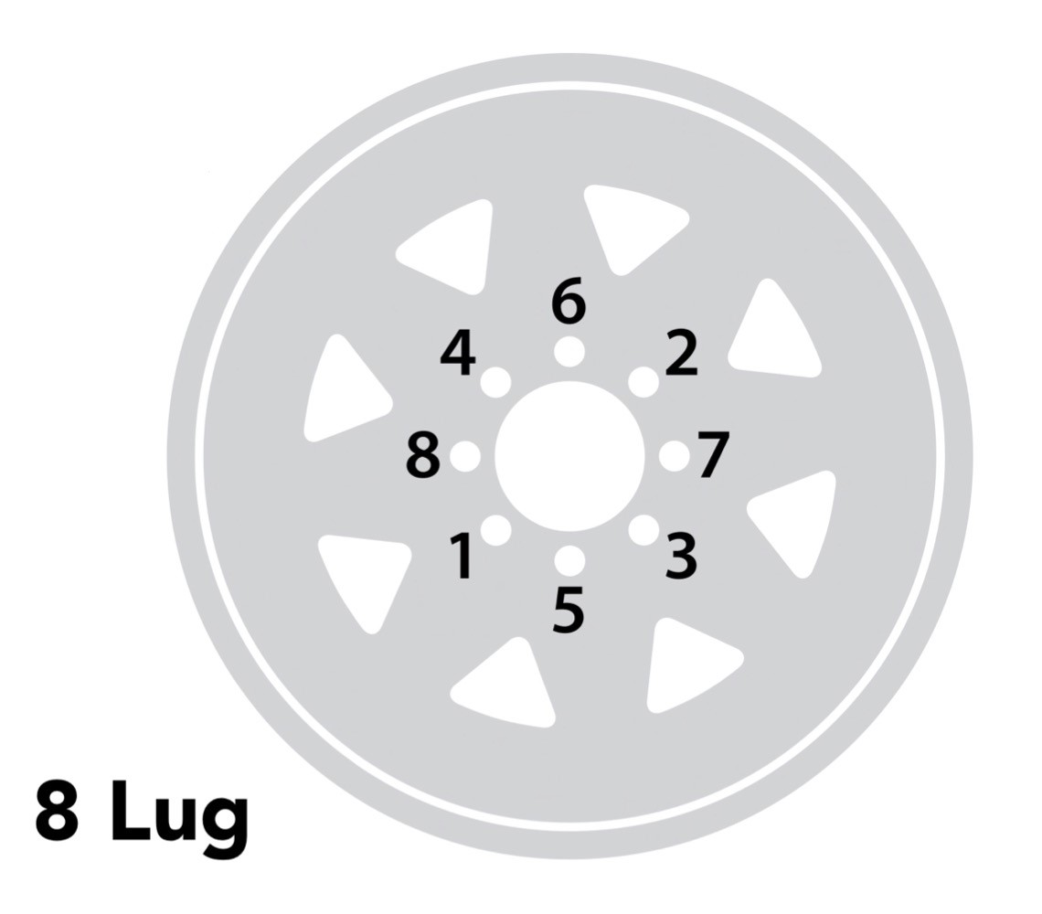
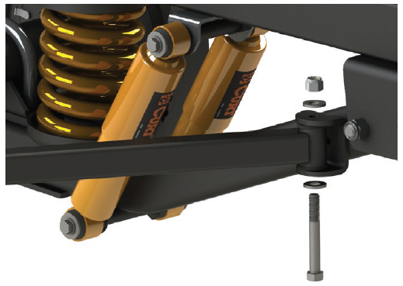
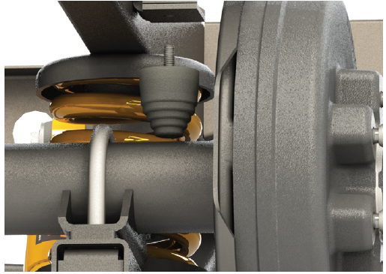
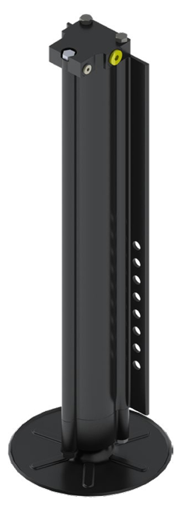
Quick Reference Torque Guide
Rev: 3/10/2025
Rota-Flex™
Pin Box
Helux
Pin Box
A: 70 ft-lb (3/4” socket on bolt, 7/8” wrench)
B: 75 ft-lb (3/4” socket)
C: 120 ft-lb (3/4” socket)
D: 120 ft-lb (15/16” socket on bolt, 15/16” wrench)
Lippert requirement: Torque wrench on bolt head only.
A: 135 ft-lb (15/16” socket, 15/16” wrench)
B: 80 ft-lb (3/4” socket)
Rota-Flex™ Pin Box Installation and Owner’s Manual
Helux Pin Box Maintenance Manual
Wheel Lug Nuts
Leaf Spring Systems
All leaf spring systems constructed similarly, regardless of equalizer. All torque values identical per location.
NOTE: Dexter U-BOLT systems using Flanged nuts require 100 ft‑lb
120 ft-lb (3/4” socket) - See torque pattern
Dexter Operation & Service manual
CRE3000 TANDEM INSTALLATION INSTRUCTIONS
Jacks & Stabilizers:
CURT Touring Coil Suspension HD
D
Fifth Wheel: 90 ft-lb (3/4” socket, 3/4” wrench) (1/2-20 Grade 8 Bolts )
Travel Trailers:
  Tongue Jack: 30 ft-lb (BAL 5.3LS)
  Rear Leveling Jacks: 90 ft-lb (BAL 5.3LS)
  Stabilizer Jacks: 30 ft-lb
B
Notes:
Lippert requirement: Torque wrench on bolt head only.
U-Bolts torqued to 100 ft-lb w Loctite at factory. No adjustment needed.
A
C
A: Shock mtg bolts: 30 ft-lb (9/16” socket)
B: Trailing Arm Bolt: 200 ft-lb (15/16” socket on bolt, 15/16” wrench)
C: Track Bar Bolt: 80 ft-lb (3/4” socket on bolt, 3/4” wrench)
D: Bump Stop Nut: Tight against metal (5/8” socket)
BAL 5.3LS User Manual
Lippert Hydraulic Jack Mounting Bolt Specification
Service Manual: Touring Coil Suspension HD
This guide is for reference only and includes some components that are not used on every Alliance RV product line. Please verify you are referencing the proper components used on your specific coach.

